Slide 1
TEAM ALPHA – ITERATION 2
Randy Charland, Allen Tshudy, chris willis, Shucheng ge, yue lei, enda peng, and vikrant sanghvi

Slide 2
agenda
Requirement Analysis
New Features
Development and Testing
Iteration 3
Demo

Slide 3
Requirement analysis
Team Alpha decided to focus on four areas for Iteration 2
Fixing bugs identified with unit tests in Iteration 1
Improving usability of Dashboard and Project Detail views
Adding an attachment feature to individual stories
Adding a backlog feature to each project

Slide 4
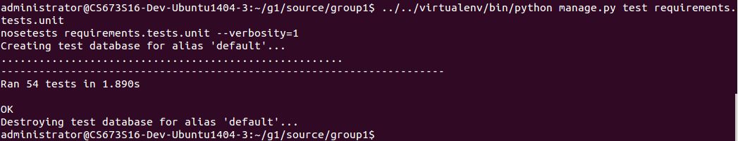
Requirement analysis
Bug fixes
Fixing iteration model such that an iteration start date can’t be earlier than today
Fixing iteration model such that an iteration end date can’t be earlier than start date
Fixing attachment template bug when a file to be uploaded is not supplied
Fixing attachment template bug when the file to be uploaded is too large

Slide 5
Requirement analysis (cont.)
Usability of Dashboard and Project Detail
Clicking on a project name within Dashboard View brings you directly to the project, instead of simply collapsing the view
As a developer, I want the project details to open when clicking on the name of it rather than having to click on the "open" link
A summary of tasks within an Iteration is shown in Project Detail
As a developer, I would like to see a summary listing of tasks within an iteration when clicking on the Project Detail page when within a project
A status of each iteration is shown in Project Detail
As developer, I should be able to see the completion status of each story within the iteration on the Project Detail page within a Project

Slide 6
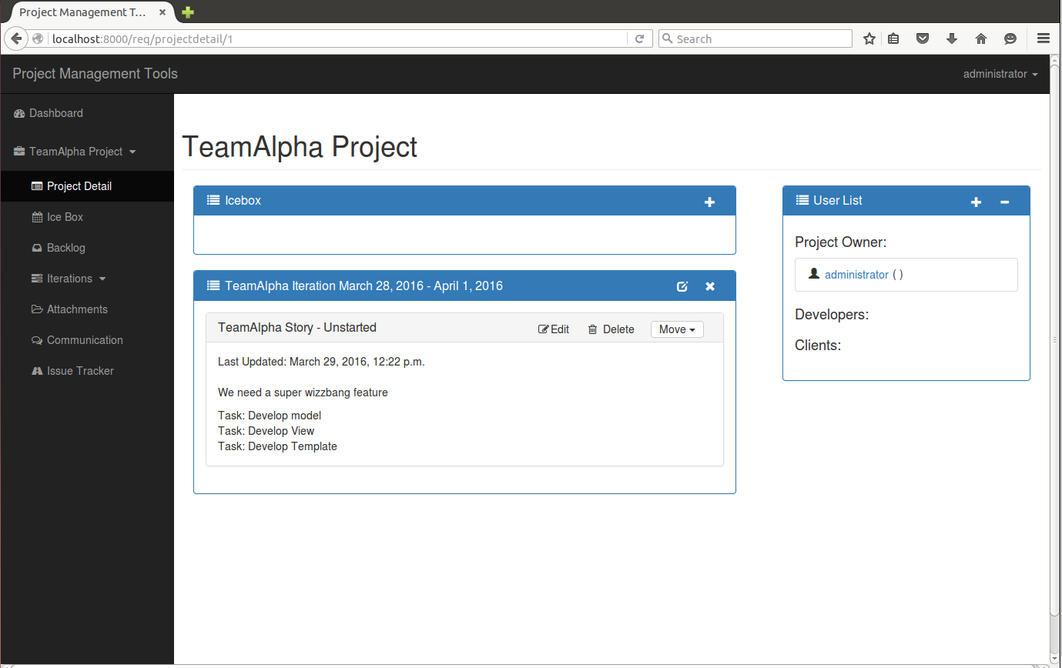
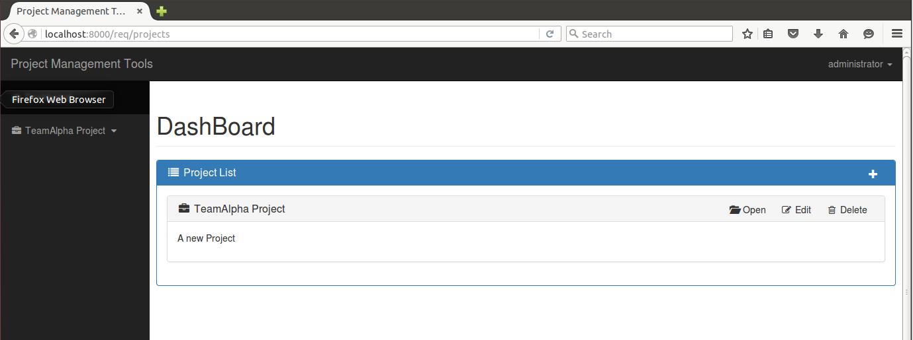
Requirement analysis (cont.)
Usability of Dashboard and Project Detail

Slide 7
Requirement analysis (cont.)
File Attachment feature for each story
We felt the existing attachment feature was limited due to not being able to determine which attachments within a project were relevant to which stories
We wanted to add an attachment feature within each story
As a developer, I want to be able to attach documents to the story, so that the attachments can be associated to a story

Slide 8
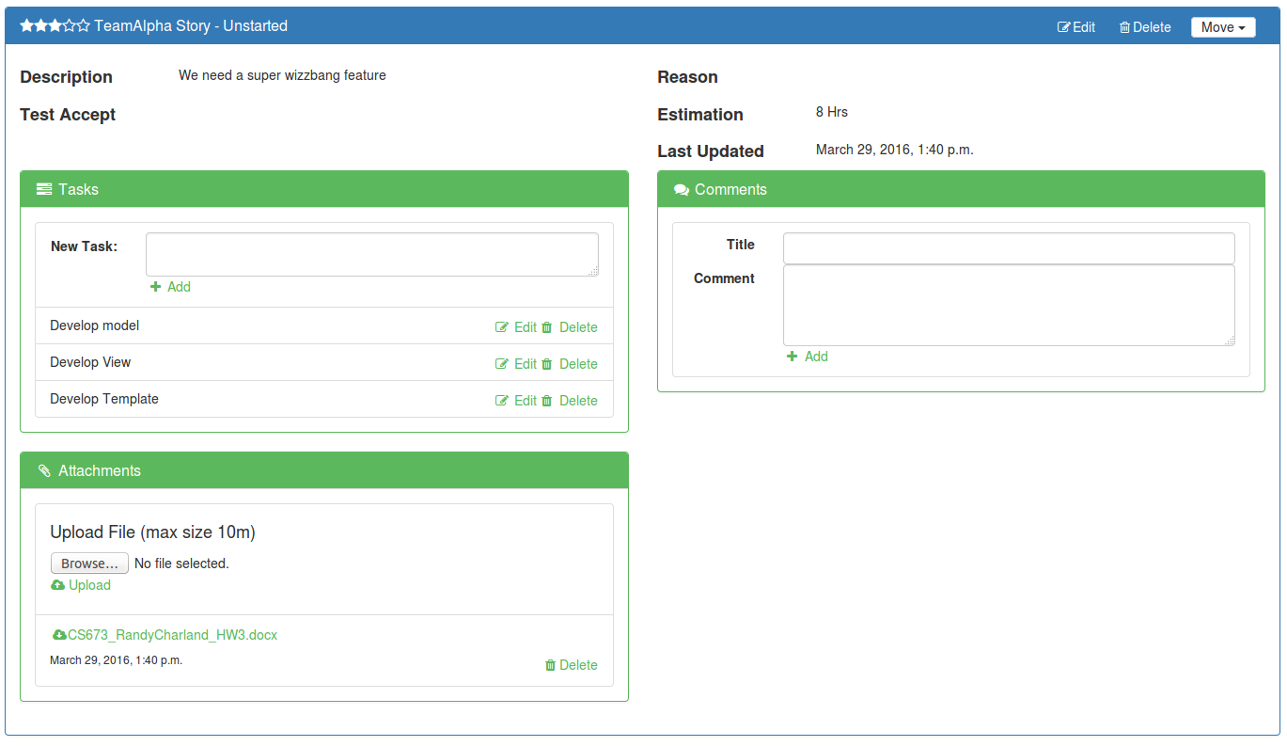
Requirement analysis (cont.)
File Attachment feature for each story

Slide 9
Requirement analysis (cont.)
Backlog Feature
We felt a Backlog story queue would be useful, to stage and prioritize stories prior to assigning them to an iteration
We wanted to create a Backlog that listed stories in priority order, in order to select and move into an iteration
As a developer, I want to visually show stories in a prioritized backlog, so that everyone can see the list of stories that need to be done in the coming iterations
The team underestimated the amount of work required, a good lesson learned
Foundation finished, still work to accomplish in Iteration 3

Slide 10
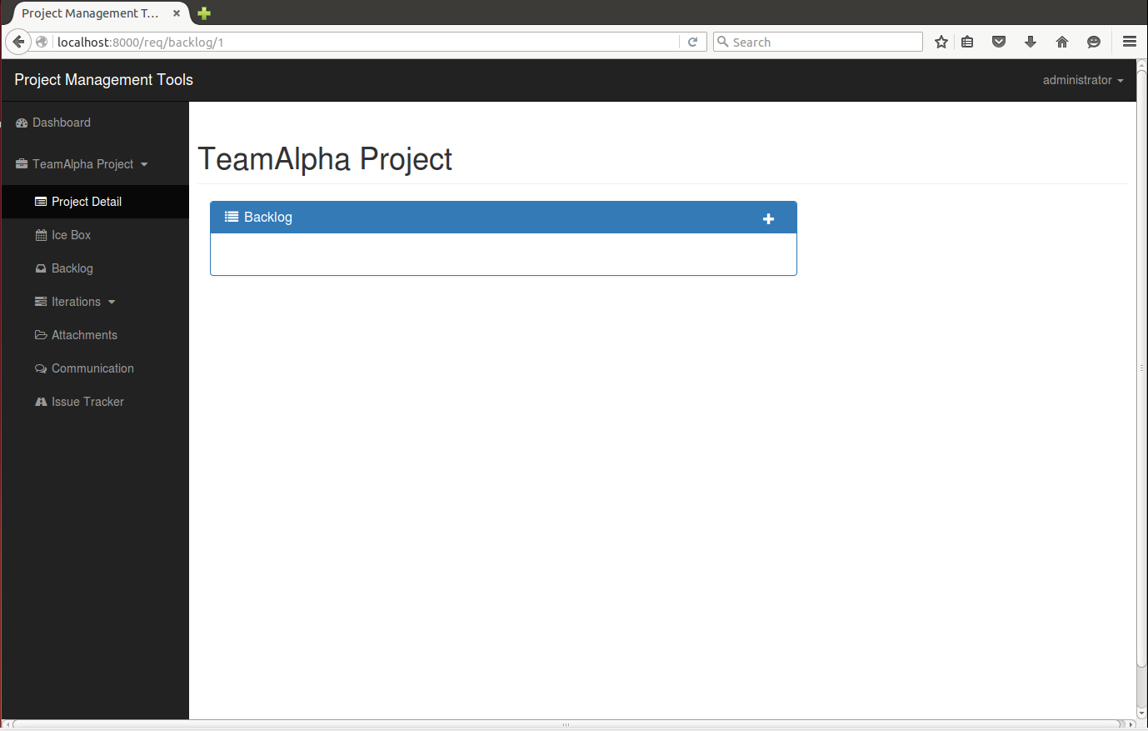
Requirement analysis (cont.)
Backlog Feature

Slide 11
Development and Testing
Worked as a single development team for Iteration 2
Team wanted to experiment with a larger development team
Single development branch on Github, no merging issues due to good feature planning
Required even more communication
Similar to Iteration 1, the team performed a code review and tested each other’s code on our individual systems
Several bugs/issues were encountered during development
Multiple eyes on a specific feature development helped resolve issues quickly as a team

Slide 12
Iteration 3
Need to finish Backlog feature
Add backlog to Project Detail view
Ability to move stories between Icebox, Backlog, and Iteration
Finalize backlog template to be similar to Icebox
Add priority to story model
Need to revisit testing
Learned about coverage and coverage needs to be improved
Continue to optimize information presented in Dashboard and Project Detail views
Possibly improve “Testing” and add “Requirements” tracing item in Story model

Slide 13
DEMO

